Slide 1


HR Specialty ROofing
Request an estimate on our website! hmrosso.weebly.com

Slide 2

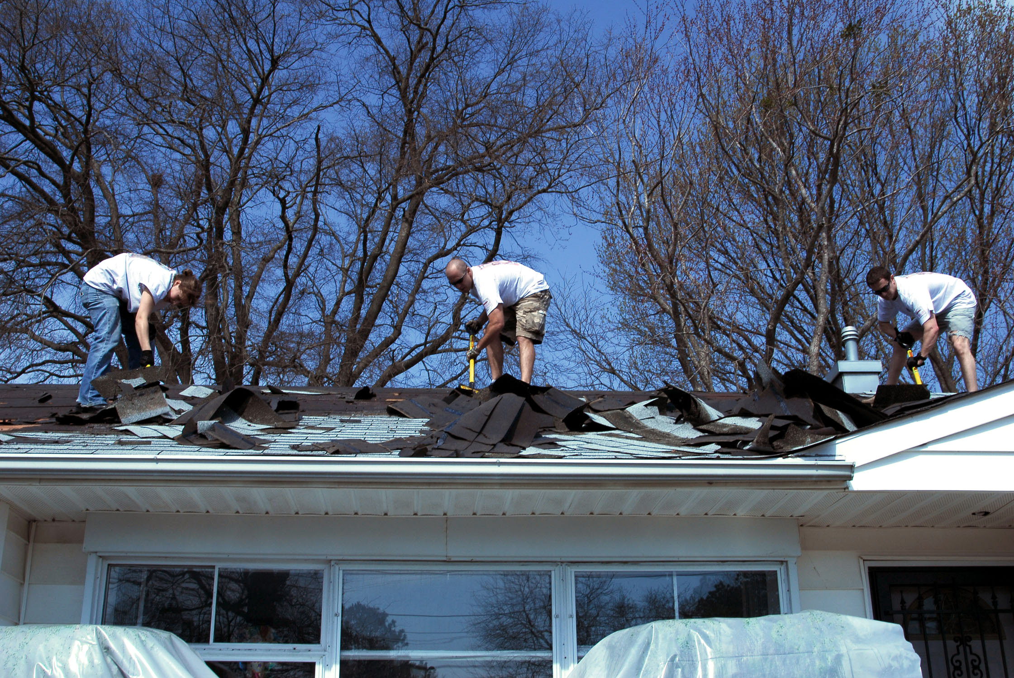
No job is too
Big
or Small

Slide 3
We specialize in:
Flat roof
Steep peaks
New homes
Repairs

Slide 4
HR Specialty ROofing
Request an estimate on our website! hmrosso.weebly.com

Slide 5


Environmental OPtions

Slide 6

Specialty Roofs
Get Noticed!

